Slide 1
OpenDSS Training Workshop
Roger Dugan and Huijuan Li
I-Shou University Kaohsiung, Taiwan March 22-23, 2016

Slide 2
Agenda
Day 1
Brief introduction to distribution systems and modeling
Introduction to DG Screener
Purpose
Installation
Tour of User Interface and Documentation
Introduction to OpenDSS
How Does OpenDSS Work?
Review of User Primer
OpenDSS Architecture
Circuit Modeling Basics in OpenDSS
OpenDSS Scripting Basics
Class Exercises
Simple Circuit
Scripting for Large Circuit Models
DG Screener Connection to OpenDSS
OpenDSS COM Interface: Exploiting the Power of the Program
Class Exercise
Driving OpenDSS via COM Interface with Excel

Slide 3
Agenda
Day 2
Loadshapes and Smart Grid Simulation – the Key to Dynamic Modeling
Examples
Modeling of Selected Volt-Var Control Devices
Modeling PV and Storage
Scripting PVSystem models
PV Loadshapes
Hosting Capacity/Streamlined Hosting Capacity
Scripting Storage models
Using DGScreener to Generate Custom OpenDSS Models
Questions and Requests
Misc. Examples/ Class Exercises
Harmonics analysis
Voltage sag analysis
Ad Hoc Examples

Slide 4
Introduction to Distribution Systems and Modeling

Slide 5
OpenDSS is Basically a Nodal Admittance Solver
OpenDSS is a script-driven, frequency-domain electrical circuit simulation tool
It uses a basic nodal admittance circuit model that could be used for a wide variety of ac circuit analysis applications
OpenDSS has specific models for:
Supporting utility distribution system analysis
Initially designed for the unbalanced, multi-phase North American power distribution systems
Can also model European-style systems
These typically have a simpler structure

Slide 6
Typical North American Distribution System
Typical 4-wire multi-grounded neutral system
Unigrounded/Delta 3-wire also common on West Coast

Slide 7
Typical European Style System
3-wire unigrounded primary
Three-phase throughout,
including secondary (LV)

Slide 8
Comparisons of Systems
European-Style System
MV
LV
North American System
MV (ALL)

Slide 9
Comparison of Distribution Systems
North American System
Primary (MV) system is extensive, complex
Secondary (LV) is short
4-5 houses per distribution transformer
120/240 V single-phase (“split phase”) service
1 Industrial customer per distribution transformer
Or multiple transformers per customer
Extended by adding transformer + wire
European Style System
MV System has simpler structure
LV System (400 V) is extensive
Perhaps 100 residences on MV/LV transformer
230/400 V 3-phase
Extended by adding wire
Fewer transformers

Slide 10
Introduction to DG Screener
An Interface to OpenDSS

Slide 11
DG Screener is a Front-end to the OpenDSS Program
Designed to support quick DG screening evaluations
Provide a quick turn-around to comply with regulatory requirements to respond to interconnection requests
Provides several templates for common circuits
Sets up the scripts for OpenDSS
Provides support for 5 screening simulations:
Voltage change
Short circuit contribution
Open conductor screen (Dynamics)
Islanding screen (Dynamics)
Fluctuations (wind & solar, principally)

Slide 12
DG Screener Structure
DG Screener
DSS Scripts
(Text)
OpenDSS COM Interface
OpenDSS
Circuit Templates and Case Files
General OpenDSS Files

Slide 13
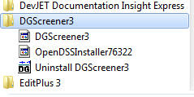
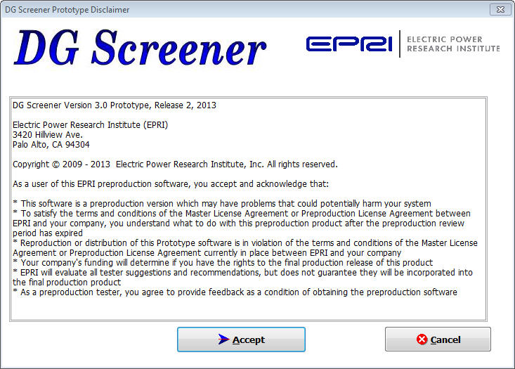
Starting DG Screener
Start Menu

Slide 14
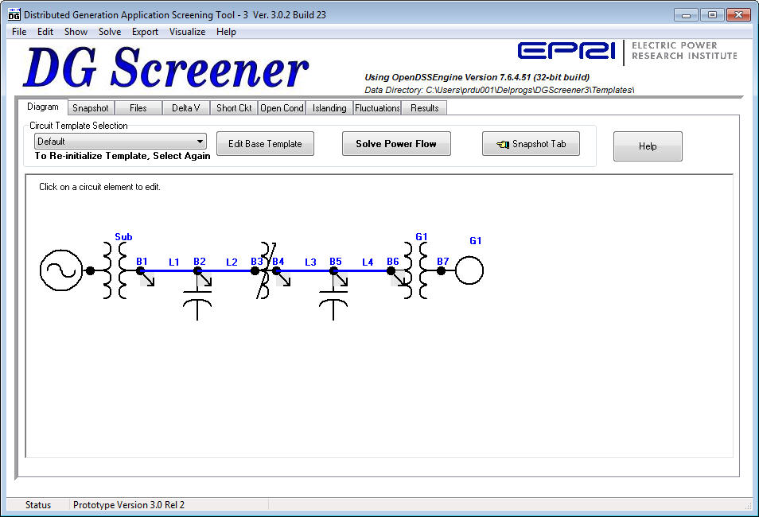
Main Screen

Slide 15
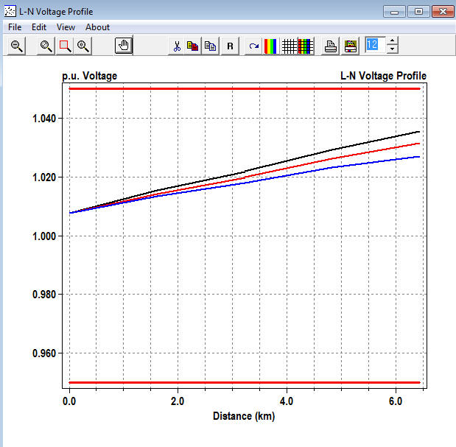
Voltage Profile for Single Power Flow

Slide 16
(Brief Demo)

Slide 17
Introduction to OpenDSS

Slide 18
OpenDSS
DSS was developed in 1997 to enable analysis of disruptive technologies such as DER
DSS acquired by EPRI in 2004
Made open source and renamed OpenDSS in 2008
To speed industry advancements in grid modernization
Over 35,000 downloads since 2008
> 170 countries
US, China, Canada, and UK lead in downloads
43,000
Brazil and India

Slide 19
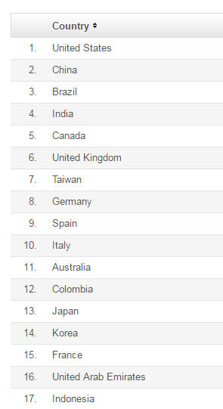
Country List …

Slide 20
What is the OpenDSS?
Heritage of OpenDSS
Harmonics solvers rather than power flow
Gives OpenDSS extraordinary distribution system modeling capability
Simpler to solve the power flow problem with a harmonics solver than vice-versa
Supports all rms steady-state (i.e., frequency domain) analyses commonly performed for utility distribution system planning
And many new types of analyses
Original purpose in 1997: DG interconnection analysis

Slide 21
What is the OpenDSS? (cont’d)
What it is NOT
An Electromagnetic transients solver (Time Domain)
It can solve Electromechanical transients
Frequency Domain => “Dynamics” mode
All solutions are in phasors (complex math)
Not a “Power Flow” program
Not a radial circuit solver
Does meshed networks with equal ease
Not a distribution data management tool
It is a simulation engine designed to work with data extracted from one or more utility databases

Slide 22
Built-in Solution Modes
Snapshot (static) Power Flow
Direct (non-iterative)
Daily mode (default: 24 1-hr increments)
Yearly mode (default 8760 1-hr increments)
Duty cycle (1 to 5s increments)
Dynamics (electromechanical transients)
Fault study
Monte carlo fault study
Harmonics
Custom user-defined solutions

Slide 23
Controls
A key feature is that controls are modeled separately from the devices being controlled
Capacitors
Regulators/tapchangers
Storage controllers
Inverter control
Switch control
Relays, Reclosers, and Fuses are controls

Slide 24
Overall Model Concept (1997)

Slide 25
Control Modes
Static
Power flows with large time steps
Time
Control queue employed to delay actions
Control acts when time is reached
Event

Slide 26
User Interfaces Currently Implemented
A stand-alone executable program that provides a text-based interface (multiple windows)
Some graphical output is also provided.
No graphical input is provided.
An in-process COM server (for Windows) that supports driving the simulator from user-written programs.
32-bit and 64-bit (New in 2012)
EPRI Program 174 funders have access to DGScreener, an interface to OpenDSS

Slide 27
Why Scripting and COM?
More flexible than static dialog forms
No two Smart Grid simulations alike
Not possible to predict what users will want to do
COM = Component Object Model
Supported by nearly all programming languages, Microsoft Office, MATLAB, Python, etc that run on Windows
Allows user to write their own algorithms
For things like DA controllers and DMS simulators
Co-simulation of power and communications
COM is not familiar to most power engineers but is powerful means of scripting

Slide 28
What is COM?
COM = Component Object Model
A binary-interface standard for software components introduced by Microsoft in 1993
Related technologies
OLE, OLE Automation, ActiveX, COM+, DCOM
A language-neutral way of implementing objects that can be used in environments different from the one in which they were created
Microsoft Office tools like Excel and Work can be Automated via COM
And VBA supports automating other apps via COM

Slide 29
OpenDSS Installation

Slide 30
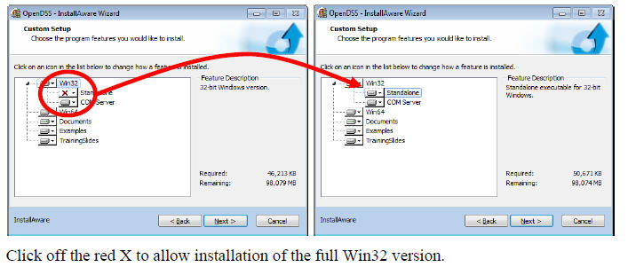
Install Both 32-bit and 64-bit Versions of OpenDSS
DG Screener and Excel typically use 32-bit OpenDSS, but both versions must be installed to get 32-bit server fully installed. Windows will figure out which one needs to be executed. Magic!!

Slide 31
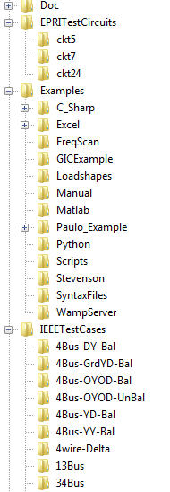
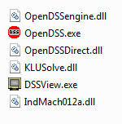
OpenDSS Files Installed
Main Program Files

Slide 32
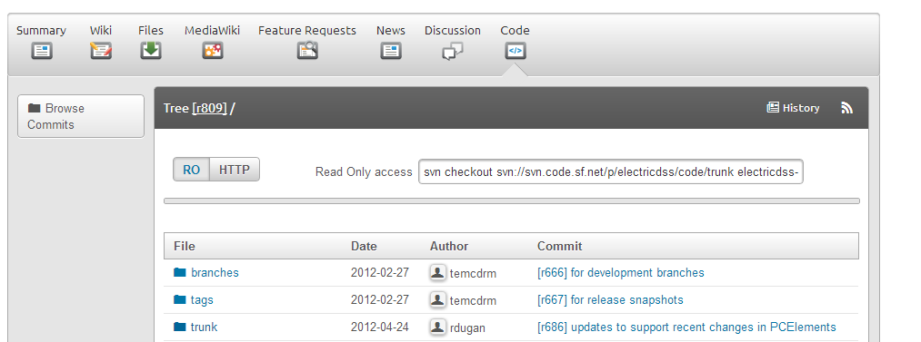
SourceForge.Net Links for OpenDSS
EPRI Links Page
http://smartgrid.epri.com/SimulationTool.aspx
OpenDSS Download Files:
http://sourceforge.net/projects/electricdss/files/
Top level of Main Repository

Slide 33
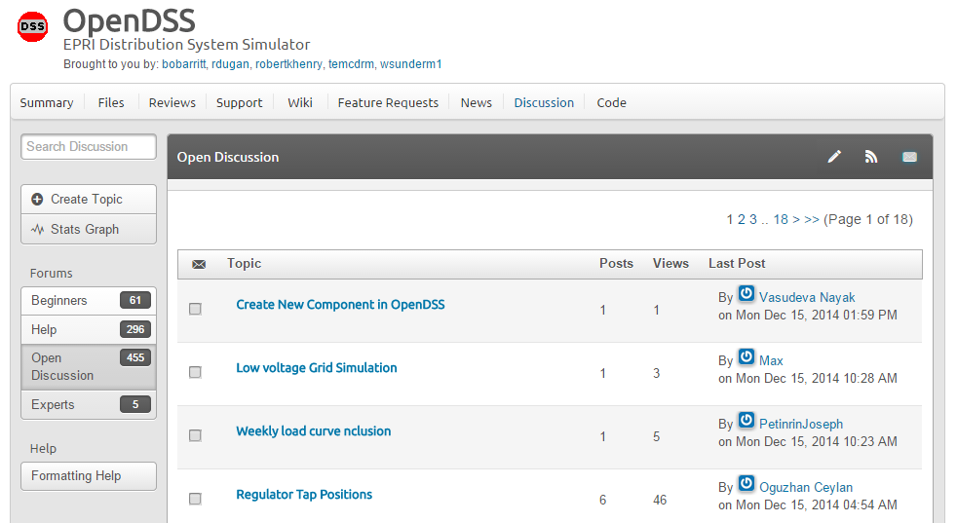
Discussion Forum & News for OpenDSS

Slide 34
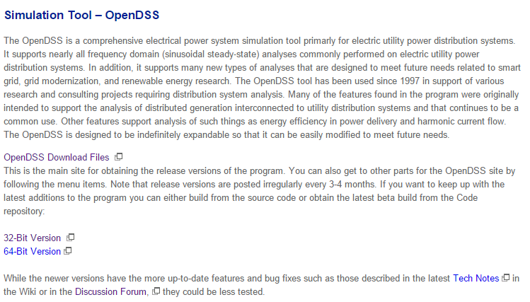
Installing
EPRI Link Page
http://smartgrid.epri.com/SimulationTool.aspx

Slide 35
Validation of OpenDSS
EPRI routinely checks OpenDSS power flow results against CYME, Synergi, WindMil, and other programs after converting data sets for various projects.
The OpenDSS program has been benchmarked against all the IEEE Test Feeders
(http://ewh.ieee.org/soc/pes/dsacom/testfeeders/).
OpenDSS was used to develop the NEV test feeder and the 8500-node test feeder.
Being used to develop the DG Protection test feeder
For the EPRI Green Circuits project, computed load characteristics were calibrated against measured data.

Slide 36
What can OpenDSS be used for?
Simple power flow (unbalanced, n-phase)
Daily loading simulations
Yearly loading simulations
Duty cycle simulations
Impulse loads
Rock crushers
Car crushers
Renewable generation

Slide 37
What has OpenDSS be used for?
Hybrid simulation of communications and power networks
Geomagnetically-Induced Current (GIC) flow (solar storms)
Power delivery loss evaluations (EPRI Green circuits program - > 80 feeders)
Voltage optimization
PEV/PHEV impact simulations
Community energy storage (EPRI Smart Grid Demo)
High-frequency harmonic/interharmonic interference
Various unusual transformer configurations
Transformer frequency response analysis
Distribution automation control algorithm assessment
Impact of tankless electric water heaters
Wind farm collector simulations
Wind farm interaction with transmission
Wind generation impact on capacitor switching and regulator/LTC tapchanger operations
Protection system simulation
Open-conductor fault conditions
Circulating currents on transmission skywires
Ground voltage rise during faults on lines
Stray voltage simulations
Industrial load harmonics studies/filter design
Distribution feeder harmonics analysis, triplen harmonic filter design
And many more ….

Slide 38
What’s Next?
It’s time to address other Distribution System Analysis problems
Microgrids
Advanced inverters
Probabilistic planning
DMS and DA
Communications and control latency
Masking of load growth by PV and other DG
Recloser siting
Training next generation distribution engineer for the “Integrated Grid”

Slide 39
EPRI’s Vision
Distribution planning and distribution management systems (DMS) will converge
Into a unified set of analysis tools.
Real-time analysis and planning analysis will merge into common tools.
Distribution system analysis tools will continue to play an important role,
Although they might appear in a much different form than today.

Slide 40
How Does OpenDSS Work?

Slide 41
The Math …
Nearly everything results in a matrix or array
Nodal Admittance formulation
Circuit elements modeled by primitive admittance matrices
Y_{prim}
Primitive Y matrices used to build System Y matrix
OpenDSS Works In
Phase domain
Actual volts and amps
Symmetrical components and per units not used inside the program !! -- Input and output only!

Slide 42
Primitive Y Matrix
Simple Resistor

Slide 43
Primitive Y Matrix, cont’d
LINE model

Slide 44
What about 3-phase elements?
Simply let R, X, B, G, C, etc. represent 3x3 matrix
Notation stays the same
And it works!
I1, I2, V1, V2 etc become 3x1 vectors
This is basically how all the Circuit Element (CktElement) models in OpenDSS work.

Slide 45
The Network Model

Slide 46
Nodal Admittance Equations
V₁
V₂
…
V_{S}
…
V_{L1}
…
V_{L2}
…
V_{N}
I₁
I₂
…
I_{S}
…
I_{L1}
…
I_{L2}
…
I_{N}
Y_{SYSTEM}
=
N x N
(Sparse)
N = Number of NODES (not BUSES)

Slide 47
Solving the Power Flow
Once the circuit model is connected properly the next step is to Solve the base power flow
PC elements (i.e., Loads) are usually nonlinear
Loads are linearized to a Norton equivalent based on nominal 100% rated voltage.
Current source is “compensation current”
Compensates for the nonlinear characteristic
A fixed point iterative solution algorithm is employed for most solutions
This method allows for flexible load models and is robust for most distribution systems

Slide 48
Load (a PC Element)
General Concept
Added into Injection Current Vector
Goes into System Y Matrix
(One-Line Diagram)
Most Power Conversion (PC) Elements are Modeled Like This

Slide 49
Load - 3-phase Y connected
Phase 1
1
2
Phase 2
3
4 Conductors/Terminal
Phase 3
4

Slide 50
Load - 3-phase Delta connected
Phase 1
2
1
Phase 2
3
3 Conductors/Terminal
Phase 3

Slide 51
Load Models (Present version)
1:Standard constant P+jQ load. (Default)
2:Constant impedance load.
3:Const P, Quadratic Q (like a motor).
4:Nominal Linear P, Quadratic Q (feeder mix). Use this with CVRfactor.
5:Constant Current Magnitude
6:Const P, Fixed Q
7:Const P, Fixed Impedance Q
8: Special ZIP load model

Slide 52
Standard P + jQ (constant power) Load Model
When the voltage goes out of the normal range for a load the model reverts to a linear load model
This generally guarantees convergence
Even when a fault is applied
This script changes break points to +/- 10%:
Load.Load1.Vmaxpu=1.10
Load.Load1.Vminpu=0.90
Note: to solve some of the IEEE Radial Test feeders and match the published results, you have to set Vminpu to less than the lowest voltage published (usually about 0.80 per unit)

Slide 53
Standard P + jQ Load Model (Model=1)
Const Z
105%
(Defaults*)
95%
|I| = |S/V|
Const Z
New Method (2014)
* Change by setting Vminpu and Vmaxpu Properties

Slide 54
Power Flow Solution Algorithm
Initial Guess at Node Voltages, V
Compute all Injection (Compensation) Currents, I
For PC Elements
Solve for new guess at V
Repeat 2 and 3 until Converged
Convergence is based on change in per unit voltage magnitude
Default tolerance = 0.0001
Good enough for distribution systems

Slide 55
Putting it All Together
ALL Elements
Yprim 1
Yprim 2
Yprim 3
Yprim n
PC Elements Comp. Currents
I1
I2
Y
Node
Voltages
I_{inj}
=
V
Im
Iteration Loop

Slide 56
Putting it All Together
Th-Th-That's All Folks !
ALL Elements
Yprim 1
Yprim 2
Yprim 3
Yprim n
PC Elements Comp. Currents
I1
I2
Y
Node
Voltages
I_{inj}
=
V
Im
Iteration Loop

Slide 57
The (new) OpenDSS Primer

Slide 58
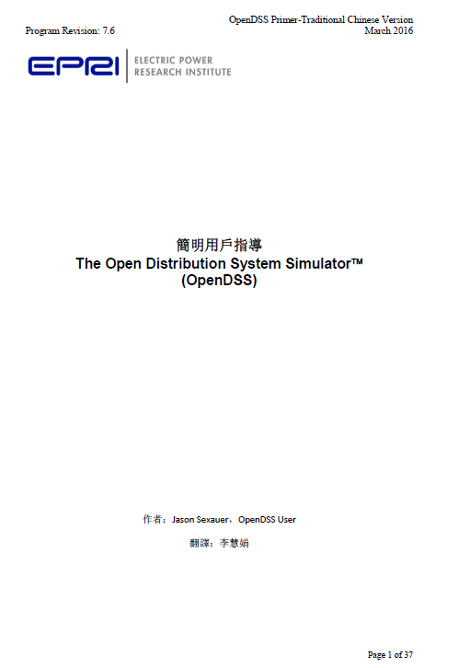
OpenDSS Primer 簡明用戶指導
下載地址https://sourceforge.net/p/electricdss/code/HEAD/tree/trunk/Distrib/Doc/OpenDSSPrimer_TranditionalChinese.pdf
主要包括：
什麽是 OpenDSS
OpenDSS模型
OpenDSS的圖形用戶界面(GUI)
OpenDSS編程基礎
COM 接口介绍
其他資源

Slide 59
什麽是 OpenDSS？(What is OpenDSS)
OpenDSS 是開放源代碼的配電網仿真計算分析軟件
頻域基於有效值（RMS）的分析軟件
它既可以作為一個獨立的執行程序使用，又可以作為動態鏈接庫（DLL）被很多其他軟件平臺調用
主要通過代碼指令來完成用戶的任務
计算模式主要包括：
幀計算（snapshot）
天計算(daily)
年計算(yearly)
諧波分析 (harmonic)
動態分析(dynamic)
故障（短路）分析(fault)
Monte Carlo 故障分析 (M1,M2,M3)

Slide 60
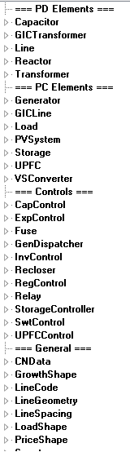
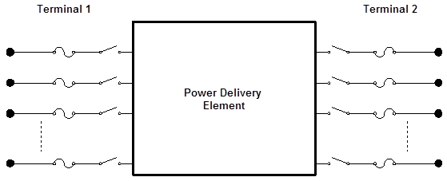
OpenDSS模型 (OpenDSS Models)
電力傳輸元件，比如傳輸線，變壓器，電容器，
電力轉換元件，例如發電機和負荷。
其他輔助模塊，例如控制，發電或負荷曲線，計量器，參數提取
動態生成母線和節點
母線≠節點
幫助文件中的模型列表

Slide 61
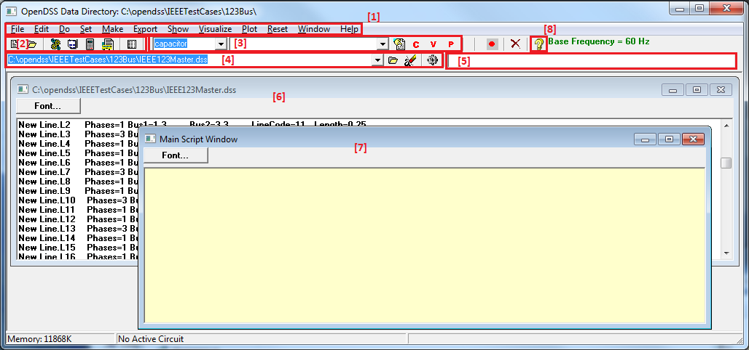
OpenDSS的圖形用戶界面(GUI)
OpenDSS是以編程為基礎的仿真工具。GUI更是一個輔助電路生成分析，調試代碼的工具,而不能取代代码指令。
菜單
Help 按鈕
工具條
元件工具
編碼工具
結果欄
代碼 Windows
主代碼 Window

Slide 62
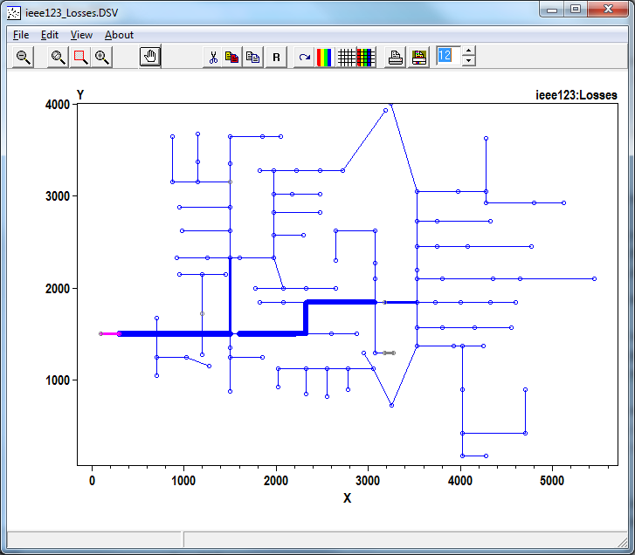
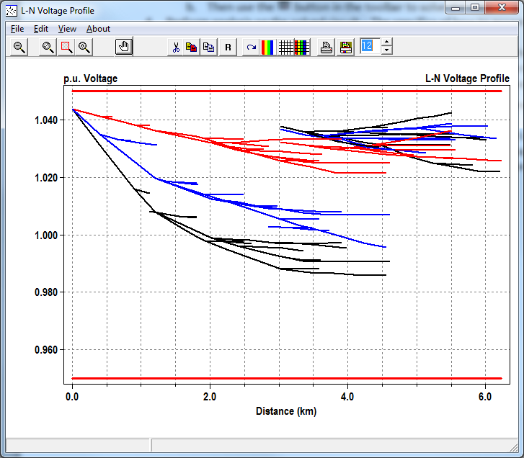
工作流程(Workflow)
定義電路
定義線路，變壓器，負荷，發電機
定義電路是通過編寫dss文件實現
設定電路的仿真計算選項
如仿真計算模式
“Set” 命令來實現
解計算問題
首先，“Calc Voltage bases”來確保生成母線節點列表和尋找到基本電壓
然後解電路
分析已解電路
檢查線路，變壓器，負荷，等元件的電流，電壓和功率
圖形化顯示電壓-距離
在線路連接圖上顯示數據
“Export”菜單中不同的命令來輸出。 結果存儲為 .csv 文件

Slide 63
更進一步 ：
OpenDSS編程
COM 接口
後面會有詳細介紹…
有问题？SourceForge 網站的OpenDSS forums
https://sourceforge.net/projects/electricdss/files/

Slide 64
Circuit Modeling Basics in OpenDSS

Slide 65
DSS Bus Model (Bus ≠ Node)
Nodes
Bus
Referring to Buses and Nodes (A Bus has 1 or more Nodes)
Bus1=BusName.1.2.3.0
(This is the default for a 3-phase circuit element)
Shorthand notation for taking the default
Bus1=BusName
Note: Sometimes this can bite you (e.g. – Transformers, or capacitors with ungrounded neutrals)

Slide 66
DSS Terminal Definition
Conductors
Circuit Elements have one or more Terminals with 1..N conductors.
Conductors connect to Nodes at a Bus
Each Terminal connects to one and only one Bus

Slide 67
Power Delivery Elements
PD Elements are Generally Completely Described by [Yprim]

Slide 68
Power Conversion Elements
I_{Term}(t) = F(V_{Term}, [State], t)
Power Conversion (PC) elements are typically connected in “shunt” with the Power Delivery (PD) elements
PC Elements may be nonlinear
Described some function of V
May be linear
e.g., Vsource, Isource
May have more than one terminal, but typically one
Load, generator, storage, etc.

Slide 69
Specifying Bus Connections
Shorthand (implicit)
New Load.LOAD1 Bus1=LOADBUS
Assumes standard 3-phase connection by default
LOADBUS
6
5
4
3
LOAD
2
1
0

Slide 70
Specifying Bus Connections
Explicit
New Load.LOAD1 Bus1=LOADBUS.1.2.3.0
Explicitly defines which node
New Load.1-PHASELOAD Phases=1 Bus1=LOADBUS.2.0
Connects 1-phase load to Node 2 and ground
1-Phase Load Example

Slide 71
Specifying Bus Connections
Default Bus templates
Node connections assumed if not explicitly declared
Element declared Phases=1
… LOADBUS.1.0.0.0.0.0.0.0.0.0. …
Element declared Phases=2
… LOADBUS.1.2.0.0.0.0.0.0.0.0. …
Element declared Phases=3
… LOADBUS.1.2.3.0.0.0.0.0.0.0. …

Slide 72
Specifying Bus Connections
Ungrounded-Wye Specification
Bus1=LOADBUS.1.2.3.4 (or some other unused Node number)
Voltage at this Node is explicitly computed (just like any other Node)

Slide 73
Possible Gotcha: Specifying Two Ungrounded-Wye Capacitors on Same Bus
MyBus
… Bus1=MyBus.1.2.3 Bus2=MyBus.5.5.5
Neutrals are not connected to each other in this specification!
… Bus1=MyBus Bus2=MyBus.4.4.4

Slide 74
Circuit Element Conductors are Connected to the Nodes of Buses
MyBus
3
2
1
0
. . . Bus2 = MyBus.2.1.3.0 . . .
. . . Bus1 = MyBus . . .
(take the default)
(Explicitly define connections)
DSS Convention: A Terminal can be connected to only one Bus. You can have any number of Nodes at a bus.

Slide 75
Example: Connections for 1-Phase Residential Transformer Used in North America
! Line-to-Neutral Connected 1-phase Center-tapped transformer
New Transformer.Example_1-ph phases=1 Windings=3
! Typical impedances for small transformer with interlaced secondaries
~ Xhl=2.04 Xht=2.04 Xlt=1.36 %noloadloss=.2
! Winding Definitions
~ wdg=1 Bus=Bus1.1.0 kV=7.2 kVA=25 %R=0.6 Conn=wye
~ wdg=2 Bus=Bus2.1.0 kV=0.12 kVA=25 %R=1.2 Conn=wye
~ Wdg=3 Bus=Bus2.0.2 kV=0.12 kVA=25 %R=1.2 Conn=wye
Note: You may use XfmrCode to define a library of transformer definitions that are used repeatedly (like LineCode for Line elements)

Slide 76
All Terminals of a Circuit Element Have Same Number of Conductors
3-Phase Transformer

Slide 77
OpenDSS Scripting Basics
Example Circuit

Slide 78
A Basic Script (Class Exercise)
New Circuit.Simple ! Creates voltage source (Vsource.Source)

Slide 79
A Basic Script (Class Exercise)
New Circuit.Simple ! Creates voltage source (Vsource.Source)
Edit Vsource.Source BasekV=115 pu=1.05 ISC3=3000 ISC1=2500 !Define source V and Z

Slide 80
A Basic Script (Class Exercise)
New Circuit.Simple ! Creates voltage source (Vsource.Source)
Edit Vsource.Source BasekV=115 pu=1.05 ISC3=3000 ISC1=2500 !Define source V and Z
New Transformer.TR1 Buses=[SourceBus, Sub_Bus] Conns=[Delta Wye] kVs= [115 12.47]
~ kVAs=[20000 20000] XHL=10

Slide 81
A Basic Script (Class Exercise)
New Circuit.Simple ! Creates voltage source (Vsource.Source)
Edit Vsource.Source BasekV=115 pu=1.05 ISC3=3000 ISC1=2500 !Define source V and Z
New Transformer.TR1 Buses=[SourceBus, Sub_Bus] Conns=[Delta Wye] kVs= [115 12.47]
~ kVAs=[20000 20000] XHL=10
New Linecode.336ACSR R1=0.058 X1=.1206 R0=.1784 X0=.4047 C1=3.4 C0=1.6 Units=kft
New Line.LINE1 Bus1=Sub_Bus Bus2=LoadBus Linecode=336ACSR Length=1 Units=Mi

Slide 82
A Basic Script (Class Exercise)
New Circuit.Simple ! Creates voltage source (Vsource.Source)
Edit Vsource.Source BasekV=115 pu=1.05 ISC3=3000 ISC1=2500 !Define source V and Z
New Transformer.TR1 Buses=[SourceBus, Sub_Bus] Conns=[Delta Wye] kVs= [115 12.47]
~ kVAs=[20000 20000] XHL=10
New Linecode.336ACSR R1=0.058 X1=.1206 R0=.1784 X0=.4047 C1=3.4 C0=1.6 Units=kft
New Line.LINE1 Bus1=Sub_Bus Bus2=LoadBus Linecode=336ACSR Length=1 Units=Mi
New Load.LOAD1 Bus1=LoadBus kV=12.47 kW=1000 PF=.95

Slide 83
A Basic Script (Class Exercise)
New Circuit.Simple ! Creates voltage source (Vsource.Source)
Edit Vsource.Source BasekV=115 pu=1.05 ISC3=3000 ISC1=2500 !Define source V and Z
New Transformer.TR1 Buses=[SourceBus, Sub_Bus] Conns=[Delta Wye] kVs= [115 12.47]
~ kVAs=[20000 20000] XHL=10
New Linecode.336ACSR R1=0.058 X1=.1206 R0=.1784 X0=.4047 C1=3.4 C0=1.6 Units=kft
New Line.LINE1 Bus1=Sub_Bus Bus2=LoadBus Linecode=336ACSR Length=1 Units=Mi
New Load.LOAD1 Bus1=LoadBus kV=12.47 kW=1000 PF=.95
set voltagebases=[115 @MV1]
Calcvoltagebases

Slide 84
A Basic Script (Class Exercise)
New Circuit.Simple ! Creates voltage source (Vsource.Source)
Edit Vsource.Source BasekV=115 pu=1.05 ISC3=3000 ISC1=2500 !Define source V and Z
Var @MV1=12.47
New Transformer.TR1 Buses=[SourceBus, Sub_Bus] Conns=[Delta Wye] kVs= [115 @MV1]
~ kVAs=[20000 20000] XHL=10
New Linecode.336ACSR R1=0.058 X1=.1206 R0=.1784 X0=.4047 C1=3.4 C0=1.6 Units=kft
New Line.LINE1 Bus1=Sub_Bus Bus2=LoadBus Linecode=336ACSR Length=1 Units=Mi
New Load.LOAD1 Bus1=LoadBus kV=12.47 kW=1000 PF=.95
set voltagebases=[115 @MV1]
Calcvoltagebases
Solve

Slide 85
A Basic Script (Class Exercise)
Show Voltages LN Nodes
Show Currents
Show Powers kVA elements
Show Voltage LN Elements
var
Var @MV1=12.47
Fileedit @lastexportfile

Slide 86
Circuit
New Circuit.Simple ! (Vsource.Source is active circuit element)
Edit Vsource.Source BasekV=115 pu=1.05 ISC3=3000 ISC1=2500
Vsource.Source
SourceBus
Source
115
kV
Short Circuit Impedance (a matrix) that yields 3000A 3-ph fault current and 2500A 1-ph fault current.
115 kV, 1.05 pu
One-Line Diagram (default is 3-phase wye-grd source)

Slide 87
Vsource Element Note
Vsource is actually a Two-terminal Device
2nd terminal defaults to connected to ground (0V)
But you can connect it between any two buses
Comes in handy sometimes
Conceptually a Thevinen equivalent
Short circuit equivalent
Actually converted to a Norton equivalent internally

Slide 88
20 MVA Substation Transformer
SourceBus
TR
1
Sub_Bus
Defining Using Arrays
Defining Winding by Winding
New Transformer.TR1 Phases=3 Windings=2
~ Buses=[SourceBus, Sub_Bus]
~ Conns=[Delta Wye]
~ kVs= [115 12.47]
~ kVAs=[20000 20000]
~ XHL=10
New Transformer.TR1 Phases=3 Windings=2 XHL=10
~ wdg=1 bus=SourceBus Conn=Delta kV=115 kVA=20000
~ wdg=2 bus= Sub_Bus Conn=wye kV=12.47 kVA=20000

Slide 89
The Line
Sub_Bus
LoadBus
LINE
1
1
Mile
,
336
New Linecode.336ACSR R1=0.058 X1=.1206 R0=.1784 X0=.4047 C1=3.4 C0=1.6 Units=kft
New Line.LINE1 Bus1=Sub_Bus Bus2=LoadBus Linecode=336ACSR Length=1 Units=Mi
Line objects may also be defined by Geometry or matrix properties.
(Rmatrix=… Xmatrix=… Cmatrix=…)

Slide 90
The Load
Loadbus
LOAD
1
1000
kW
0
.
95
PF
New Load.LOAD1 Bus1=LoadBus kV=12.47 kW=1000 PF=.95
For 3-phase loads, use L-L kV and total kW
For 1-phase loads, typically use L-N kV and total kW unless L-L-connected; Then use L-L kV.

Slide 91
Solving and Showing Results Reports
Solve
Show summary (power flow summary)
Show Voltages
Show Currents
Show Powers kVA elements
Also
Export … (creates CSV files)
Plot …

Slide 92
Scripting for Larger Circuits
How to organize scripts for larger problems
Examination of how the IEEE 8500-Node Test Feeder model is organized

Slide 93
Scripting Large Circuits
For small circuits, often put all the scripts in one file
Some IEEE test feeder examples are mostly in one file
When you have large amounts of data, a more disciplined approach is recommended using multiple files:
Redirect Command
Redirects the input to another file
Returns to home directory
Compile Command
Same as Redirect except repositions home directory

Slide 94
Organizing Your Main Screen
OpenDSS.exe saves all windows on the main screen
They appear where you left them when you shut down
The next time you start up, you can resume your work
Values are saved in the Windows Registry
Come up with a way you are comfortable with

Slide 95
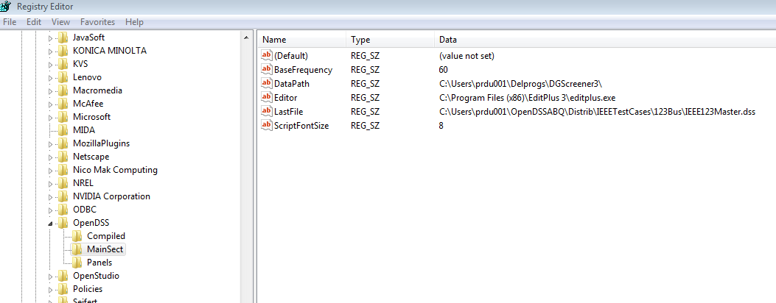
OpenDSS Registry Entries
Certain persistent values are saved to the Windows Registry upon exiting the program
Default Editor Setting

Slide 96
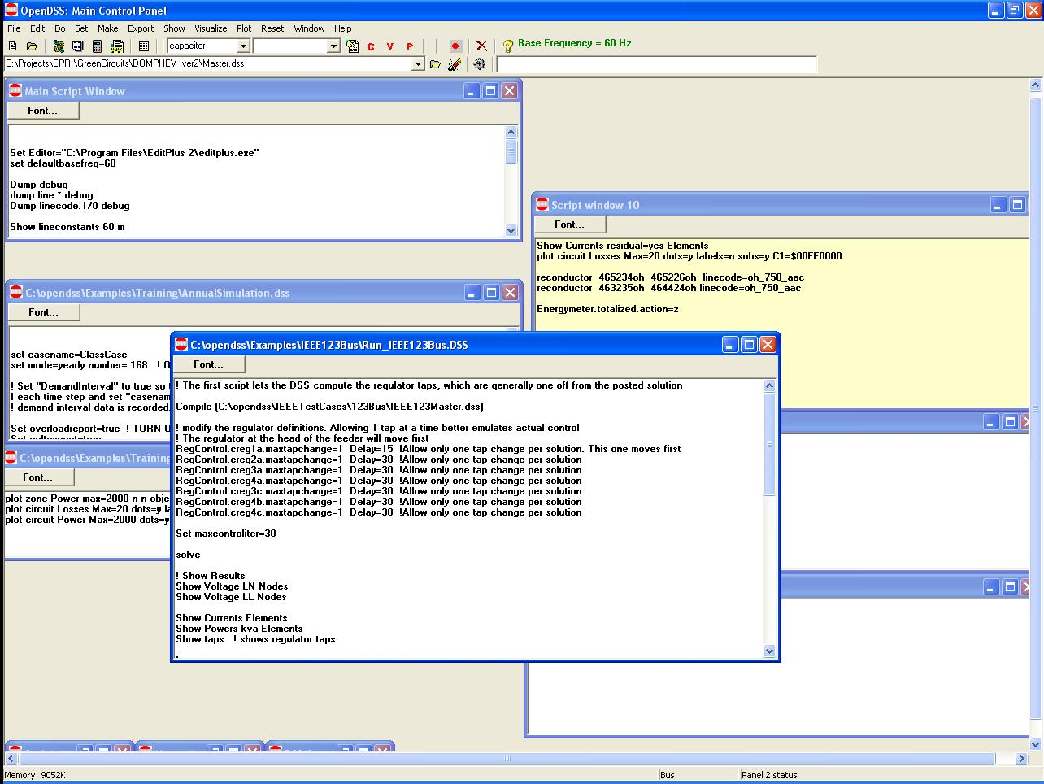
Organizing Your Main Screen
Main Script Window never goes away. Put some frequently-used commands here.
Annual Simulation Script
Misc. Scripts
Plotting Scripts
Project Run window

Slide 97
A Common Sense Structuring of Script Files
Run_The_Master.DSS
“Compile” the Master file from here
Master.DSS
LineCodes.DSS
WireData.DSS
LineGeometry.DSS
Libraries
Put a “Clear” in here
Spectrum.DSS
LoadShape.DSS
Transformers.DSS
Lines.DSS
Circuit Definition
Make a separate folder for each circuit
Loads.DSS
Etc.

Slide 98
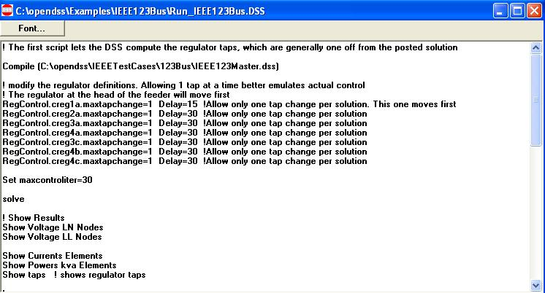
Organizing Run Scripts
Based on 123-bus Test Feeder
Compiles the Circuit Description
Override Some Property Settings and/or Define Some Additional Circuit Element
Change an option
Solve Snapshot Power Flow
Selected Results Display

Slide 99
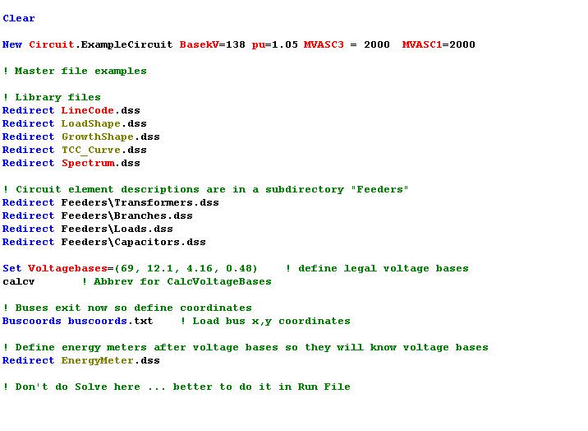
Organizing Your Master File
So Compile Doesn’t Fail
General Library Data
Circuit Elements for this Model
Let OpenDSS Define the Voltage Bases
(You can do this explicitly with SetkVBase command)

Slide 100
Example: IEEE 8500-Node Test Feeder

Slide 101
Main Part of “Run” File
Compile base circuit description
Add an energymeter not in base description
Change an option
Solve
Compile (C:\DSSdata\IEEETest\8500Node\Master-unbal.dss)
! Put an Energymeter at the head of the feeder New Energymeter.m1 Line.ln5815900-1 1
! Sometimes the solution takes more than the default 15 iterations Set Maxiterations=20
Solve

Slide 102
The Master File
Clear
New Circuit.IEEE8500u
! Make the source stiff with small impedance
~ pu=1.05 r1=0 x1=0.001 r0=0 x0=0.001
Redirect LineCodes2.dss
Redirect Triplex_Linecodes.dss
Redirect Lines.dss
Redirect Transformers.dss
Redirect LoadXfmrs.dss ! Load Transformers
Redirect Triplex_Lines.dss
Redirect UnbalancedLoads.dss
Redirect Capacitors.dss
Redirect CapControls.dss
Redirect Regulators.dss
! Let DSS estimate the voltage bases
Set voltagebases=[115, 12.47, 0.48, 0.208]
Calcvoltagebases ! This also establishes the bus list
! Load in bus coordintes now that bus list is established
Buscoords Buscoords.dss

Slide 103
(Demo of IEEE 8500-Node Case)

Slide 104
DGScreener Connection to OpenDSS

Slide 105
DG Screener Structure
DG Screener
DSS Scripts
(Text)
OpenDSS COM Interface
OpenDSS
Circuit Templates and Case Files
General OpenDSS Files

Slide 106
OpenDSS COM Interface

Slide 107
Two Implementations of OpenDSS
Stand-alone EXE
32-bit
64-bit
Use this to develop text scripts to study problems
In-Process COM Server
32-bit
64-bit
Use this to link OpenDSS to other programs
Automate the program
Execute complex algorithms

Slide 108
DSS Structure
Text
Scripts
Main Simulation Engine
COM Interface
User-Written DLLs
Scripts, Results

Slide 109
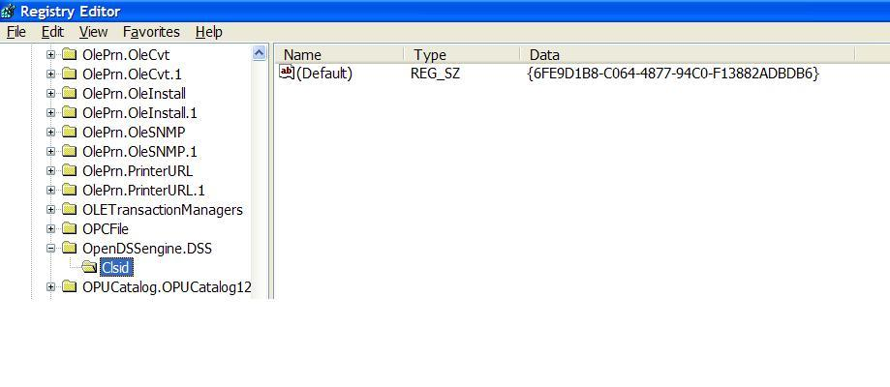
OpenDSSEngine.DSS is Registered
Windows Registry Entry
GUID
The Server shows up as “OpenDSSEngine.DSS” in the Windows Registry
The OpenDSS is now available to any program on the computer

Slide 110
Linking Your Program to the COM Server
Examples of accessing the COM server in various languages
In MATLAB:
DSSobj = actxserver(‘OpenDSSEngine.DSS’);
In VBA:
Public DSSobj As OpenDSSEngine.DSS Set DSSobj = New OpenDSSEngine.DSS
In Dephi
{Import Type Library}
Type DSSObj : IDSS; ⬅ This is how DG Screener does it!
…
DSSObj := coDSS.Create;

Slide 111
Linking Your Program to the COM Server, 2
In PYTHON:
Import win32com.client
Class DSS:
self.engine = win32com.client.Dispatch("OpenDSSEngine.DSS")
In C#:
(Project >Add Reference … select OpenDSSEngine)
Using OpenDSSEngine;
Public DSS DSSObj;
DSSObj = new DSS();

Slide 112
OpenDSS COM Interfaces
There are many interfaces supplied by the COM server
There is one registered In-Process COM interface:
OpenDSSEngine.DSS
The DSS interface is the one your program instantiates
The DSS interface then creates all the others.
This is for simplicity for users who are not necessarily familiar with COM programming

Slide 113
“Active objects” concept
.The interfaces generally act on the ACTIVE object
Active circuit,
Active circuit element,
Active bus, etc.
The interfaces generally point to the active object
To work with another object, change the active object
There are methods for selecting objects
You may also use script commands

Slide 114
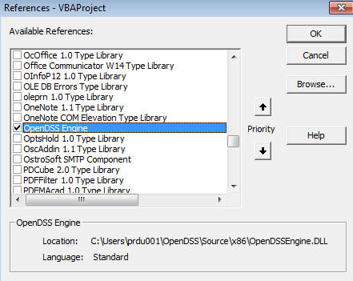
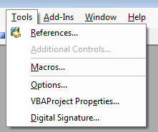
Viewing the COM Interface
The easiest way for most users to view the OpenDSS COM interface is to use Microsoft Excel
Procedure
Start Excel
Alt-F11 to open VBA Editor
Connect to OpenDSS Engine via Tools>References

Slide 115
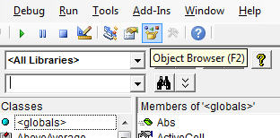
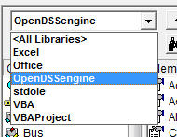
Viewing the COM Interface
Open the Object Browser (F2)
Change to OpenDSSEngine library only

Slide 116
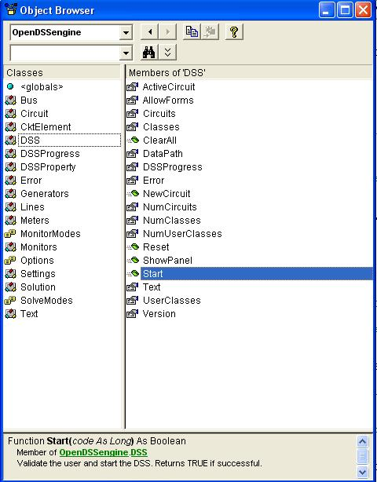
The DSS Interface
This is the main interface. It is instantiated upon loading OpenDSSEngine.DSS and then instantiates all other interfaces internally
Call the Start(0) method to initialize the DSS
DSS Class Functions (methods) and Properties

Slide 117
Class Exercise: COM interface with VBA Example
To run the IEEE 123-bus Test Feeder and plot the voltage profile using the OpenDSS COM interface

Slide 118
Steps Required to Do This
Register OpenDSSEngine.DLL (32-bit)
Start Microsoft Excel
Type alt-F11 to open VBA editor
Or Tools>Macro …
Select OpenDSS Engine under Tools>References
Insert>Module
Enter the VBA code into blank module
Use correct path name for your computer
Execute the macro “MyMacro”

Slide 119
The Code …
Option Explicit
Public MyOpenDSS As OpenDSSengine.DSS
Public MyText As OpenDSSengine.Text
Public MyCircuit As OpenDSSengine.Circuit
Public Sub MyMacro()
Set MyOpenDSS = New OpenDSSengine.DSS
MyOpenDSS.Start (0)
Set MyText = MyOpenDSS.Text
Set MyCircuit = MyOpenDSS.ActiveCircuit
MyText.Command = "Compile (C:\OpenDSS\IEEETestCases\123Bus\IEEE123Master.dss)"
MyText.Command = "New Energymeter.M1 element=Line.L115 terminal=1"
MyText.Command = "Solve"
Dim MyVoltages As Variant
Dim MyNames As Variant
Dim Mydistances As Variant
MyVoltages = MyCircuit.AllBusVmagPu
MyNames = MyCircuit.AllNodeNames
Mydistances = MyCircuit.AllNodeDistances
Dim i As Integer, irow As Integer
irow = 1
For i = LBound(MyVoltages) To UBound(MyVoltages)
ActiveSheet.Cells(irow, 1).Value = MyNames(i)
ActiveSheet.Cells(irow, 2).Value = Mydistances(i)
ActiveSheet.Cells(irow, 3).Value = MyVoltages(i)
irow = irow + 1
Next I
Set MyOpenDSS = Nothing
End Sub
Change this to Your Path

Slide 120
Resulting Chart in Excel

Slide 121
Other Excel Macros and Tips

Slide 122
VBA Example
Option Explicit
Public DSSobj As OpenDSSengine.DSS
Public DSSText As OpenDSSengine.Text
Public DSSCircuit As OpenDSSengine.Circuit
Public Sub StartDSS()
' Create a new instance of the DSS
Set DSSobj = New OpenDSSengine.DSS
' Assign a variable to the Text interface for easier access
Set DSSText = DSSobj.Text
' Start the DSS
If Not DSSobj.Start(0) Then MsgBox "DSS Failed to Start"
End Sub
Define some public variables that are used throughout the project
This routine instantiates the DSS and starts it. It is also a good idea at this time to assign the text interface variable.

Slide 123
VBA Example
Public Sub LoadCircuit(fname As String)
' Always a good idea to clear the DSS when loading a new circuit
DSSText.Command = "clear"
' Compile the script in the file listed under "fname" cell on the main form
DSSText.Command = "compile " + fname
' The Compile command sets the current directory the that of the file
' Thats where all the result files will end up.
' Assign a variable to the Circuit interface for easier access
Set DSSCircuit = DSSobj.ActiveCircuit
End Sub
This subroutine loads the circuit from the base script files using the Compile command through the Text interface. “fname” is a string contains the name of the master file.
There is an active circuit now, so assign the DSSCircuit variable.

Slide 124
VBA Example
Public Sub LoadSeqVoltages()
' This Sub loads the sequence voltages onto Sheet1 starting in Row 2
Dim DSSBus As OpenDSSengine.Bus
Dim iRow As Long, iCol As Long, i As Long, j As Long
Dim V As Variant
Dim WorkingSheet As Worksheet
Set WorkingSheet = Sheet1 'set to Sheet1 (target sheet)
iRow = 2
For i = 1 To DSSCircuit.NumBuses ' Cycle through all buses
Set DSSBus = DSSCircuit.Buses(i) ' Set ith bus active
' Bus name goes into Column 1
WorkingSheet.Cells(iRow, 1).Value = DSSCircuit.ActiveBus.Name
' Load sequence voltage magnitudes of active bus into variant array
V = DSSBus.SeqVoltages
' Put the variant array values into Cells
' Use Lbound and UBound because you don't know the actual range
iCol = 2
For j = LBound(V) To UBound(V)
WorkingSheet.Cells(iRow, iCol).Value = V(j)
iCol = iCol + 1
Next j
iRow = iRow + 1
Next i
End Sub
This Sub puts the sequence voltage onto a spreadsheet
Define a variable for the Bus interface
Define a variant to pick up the arrays
Cycle through all the buses
Get the bus name
Get the voltages into the variant array
Put them on the spreadsheet

Slide 125
Loadshapes and Smart Grid Simulation: The Key to Dynamic Modeling

Slide 126
Modeling Solar PV

Slide 127
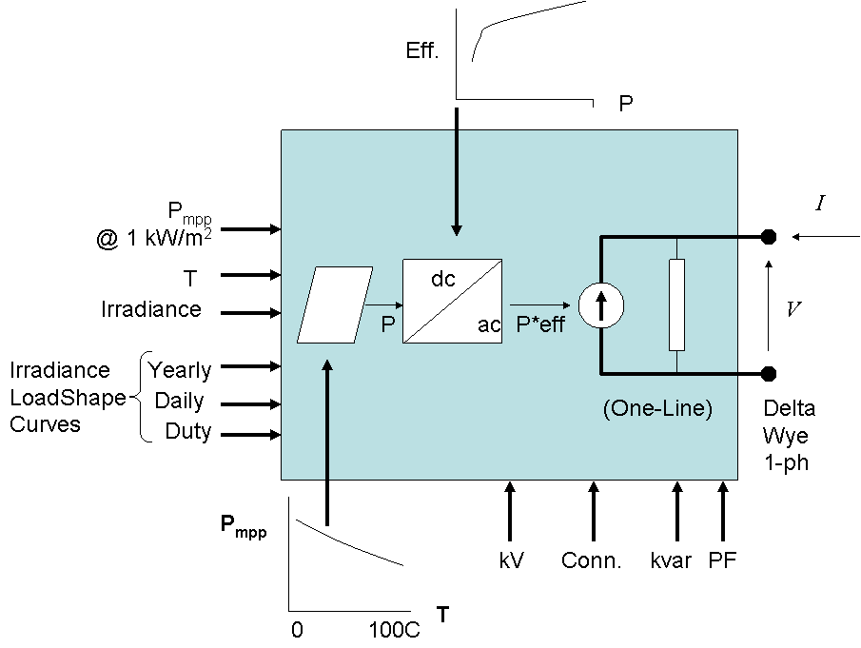
PVSystem in the OpenDSS
The PVSystem model combines a model of the PV array and the PV inverter into one convenient model to use for distribution system impacts studies

Slide 128
Example Script
This example defines a PV system with a panel Pmpp of 500 kW at 1 kW/m² irradiance and a panel temperature of 25°C. The inverter is rated at 500 kVA. A PF of 1.0 is assumed for this example.
Can also be used with the InvControl control object that implements advanced (‘smart’) inverter functions such as volt-var, volt-watt, and dynamic reactive current.
InvControl usage to be covered later today

Slide 129
Example Script
clear
New Circuit.PVSystem basekv=12.47 Isc3=1000 Isc1=900
// P-T curve is per unit of rated Pmpp vs temperature
// This one is for a Pmpp stated at 25 deg
New XYCurve.MyPvsT npts=4 xarray=[0 25 75 100] yarray=[1.2 1.0 0.8 0.6]
// efficiency curve is per unit eff vs per unit power
New XYCurve.MyEff npts=4 xarray=[.1 .2 .4 1.0] yarray=[.86 .9 .93 .97]
// per unit irradiance curve (per unit if "irradiance" property)
New Loadshape.MyIrrad npts=24 interval=1 mult=[0 0 0 0 0 0 .1 .2 .3 .5 .8 .9 1.0 1.0 .99 .9 .7 .4 .1 0 0 0 0 0]
// 24-hr temp shape curve
New Tshape.MyTemp npts=24 interval=1 temp=[25, 25, 25, 25, 25, 25, 25, 25, 35, 40, 45, 50 60 60 55 40 35 30 25 25 25 25 25 25]
// **** plot tshape object=mytemp
// take the default line
New Line.line1 Bus1=sourcebus bus2=PVbus Length=2

Slide 130
Example Script (cont’d)
! PV definition
New PVSystem.PV phases=3 bus1=PVbus kV=12.47 kVA=500 irrad=0.8 Pmpp=500
~ temperature=25 PF=1 effcurve=Myeff P-TCurve=MyPvsT
~ Daily=MyIrrad TDaily=MyTemp
set voltagebases=[12.47]
calcv
solve ! solves at the specified irradiance and temperature
new monitor.m1 PVSystem.PV 1 mode=1 ppolar=no
new monitor.m2 PVSystem.PV 1
solve
solve mode=daily
show mon m1
show mon m2

Slide 131
Example Script (cont’d)
Export monitors m1
Plot monitor object= m1 channels=(1 )
Export monitors m2
Plot monitor object= m2 channels=(1 ) base=[7200]
Export monitors m2
Plot monitor object= m2 channels=(9 )

Slide 132
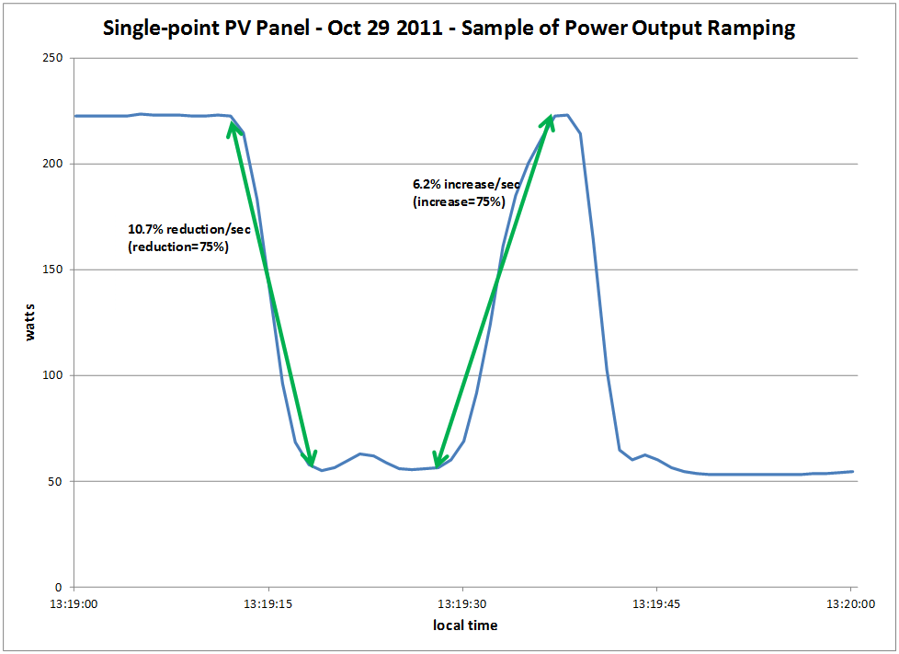
Modeling PV Systems – Variability/Ramping – Single-Panel

Slide 133
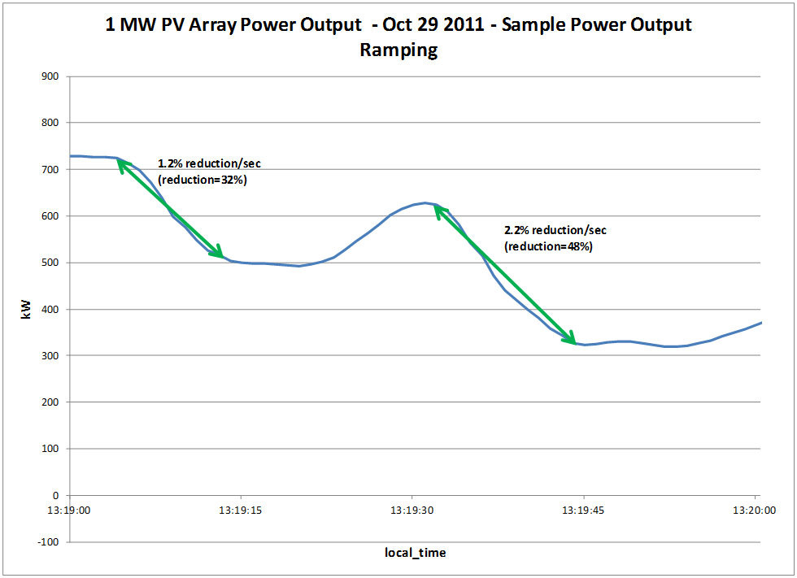
Modeling PV Systems – Variability/Ramping – 1 MW PV Array (same location as Single-Panel)

Slide 134
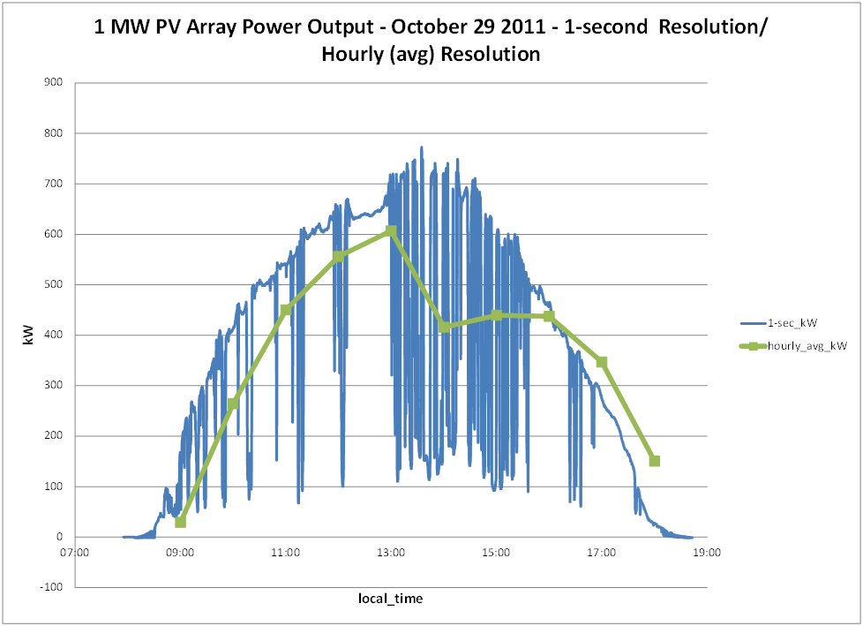
Modeling PV Systems – Variability/Ramping – Significance of Solar Irradiance Resolution

Slide 135
Modeling PV Systems for Distribution System Impact Assessment – Fault Response
Fault current contribution
‘Rule-of-thumb’: 2 x Full Output Rating of Inverter for 1 cycle (three-phase fault)
Other testing has been performed by Southern California Edison, NREL, PV inverter manufacturers, etc
NREL
1 kW inverter: 4 x pre-fault output current for 1.6 ms
PV Inverter Manufacturer (un-named)
500 kva grid-tied: 2 – 3 times pre-fault output current for up to 4.25 ms

Slide 136
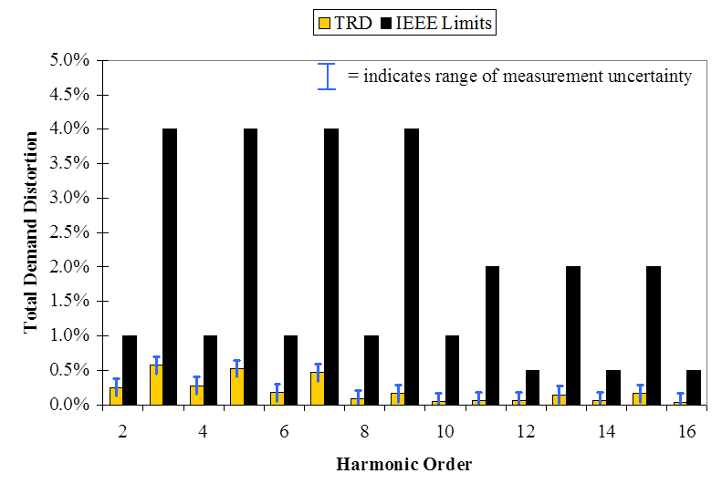
Modeling PV Systems for Distribution System Impact Assessment – Harmonic Response
Single units – Model as current sources
Typically below IEEE 519-1992 current injection limits for generation equipment, especially at low harmonic orders
Multiple units – Model as current sources with cancellation at higher order harmonics

Slide 137
Modeling PV Systems for Distribution System Impact Assessment – Anti-Islanding
Difficult to model without explicit knowledge of the anti-islanding scheme implementation details for the PV System
Implementation details for the PV Systems are usually ‘trade secrets’ and therefore not publicly available for use
See, for more information on approaches: “Evaluation of Islanding Detection Methods for Photovoltaic Utility Interactive Power Systems”, International Energy Agency, March 2002.
Precise re-creation of events in EMTP-like programs, from ‘in-the-field’ system event recordings will likely be difficult with generic models of anti-islanding approaches

Slide 138
‘Smart’ Inverter Control in the OpenDSS
InvControl

Slide 139
InvControl Control Object
Works in conjunction with PVSystem object(s) to control the PVSystem(s) output according to ‘smart’ inverter functions
Three modes currently available:
Volt-var
Follows a voltage versus reactive power curve and changes the reactive power generation (capacitive) or reactive power absorption (inductive) according to the terminal voltage at each PVSystem
Volt-watt
Follows a voltage versus active power curve and changes the active power output according to the terminal voltage at each PVSystem (within the limits of the present irradiance)
Dynamic Reactive Current (DRC)
Has several settings that change the reactive power generation or absorption in response to fast changes in terminal voltage (e.g., during a sag or swell)

Slide 140
Volt-var Control Mode – Example Volt-var Curve

Slide 141
InvControl in Volt-var Mode – Script
New PVSystem.3P_ExistingSite4 phases=3 bus1=B51854_sec kV=0.4157 kVA=523 ~ irradiance=1 Pmpp=475 pf=1 %cutin=0.1 %cutout=0.1 yearly=PV_ls
New PVSystem.3P_ExistingSite1 phases=3 bus1=X_5865228330A kV=0.4157 kVA=314 ~ irradiance=1 Pmpp=285 pf=1 %cutin=0.1 %cutout=0.1 yearly=PV_ls
New PVSystem.3P_ExistingSite3 phases=3 bus1=X_5891328219_Cust1 kV=0.4157 ~ kVA=836 irradiance=1 Pmpp=760 pf=1 %cutin=0.1 %cutout=0.1 yearly=PV_ls
New PVSystem.3P_ExistingSite2 phases=3 bus1=B4832_sec kV=0.4157 kVA=209 ~ irradiance=1 Pmpp=190 pf=1 %cutin=0.1 %cutout=0.1 yearly=PV_ls
New XYCurve.vv_curve npts=4 Yarray=(1.0,1.0,-1.0,-1.0) ~ XArray=(0.5,0.95,1.05,1.5)
New InvControl.InvPVCtrl mode=VOLTVAR voltage_curvex_ref=rated ~ vvc_curve1=vv_curve EventLog=yes

Slide 142
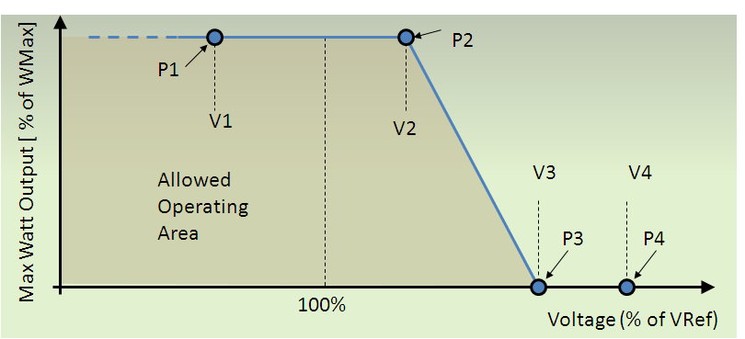
Volt-watt Control Mode – Example Volt-watt Curve

Slide 143
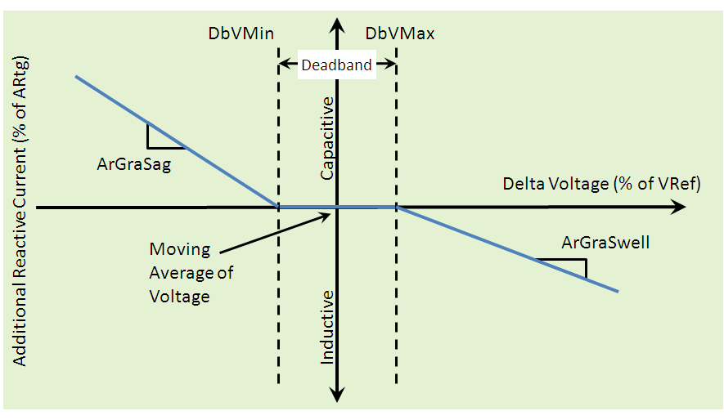
DRC Control Mode – Settings Curve

Slide 144
Solar PV Analysis and Hosting Capacity

Slide 145
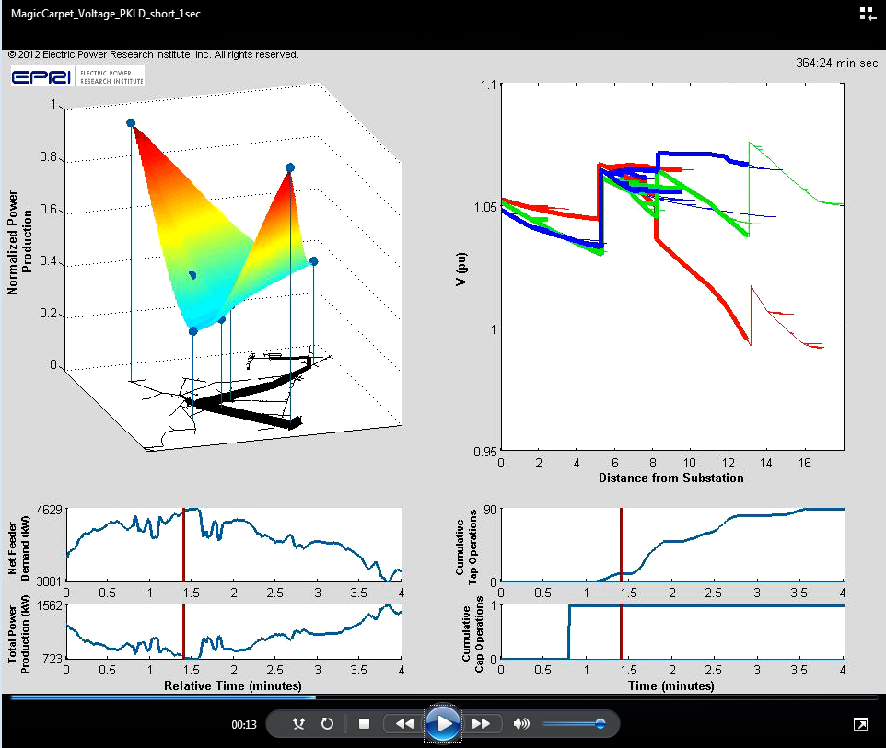
Cloud Transients and Voltage Regulation
(Movie Demo)

Slide 146
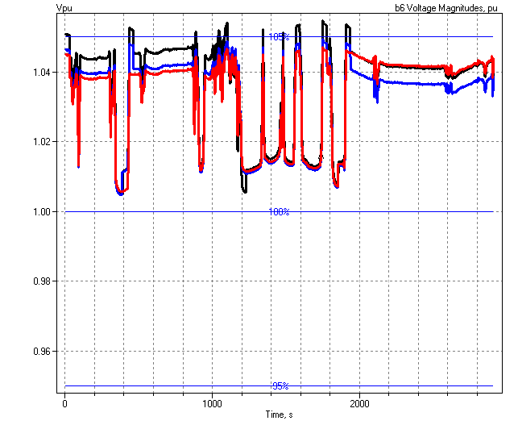
Regulator Response for Series of Cloud Transients
Regulator Operations

Slide 147
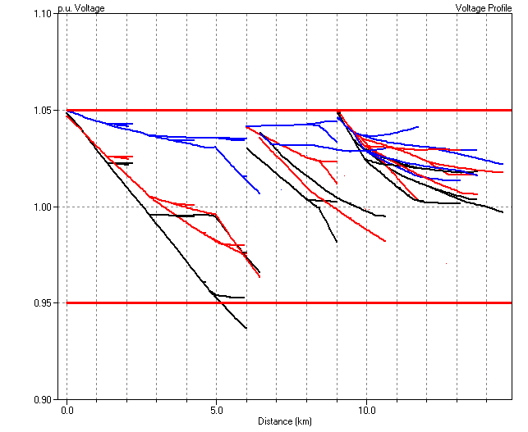
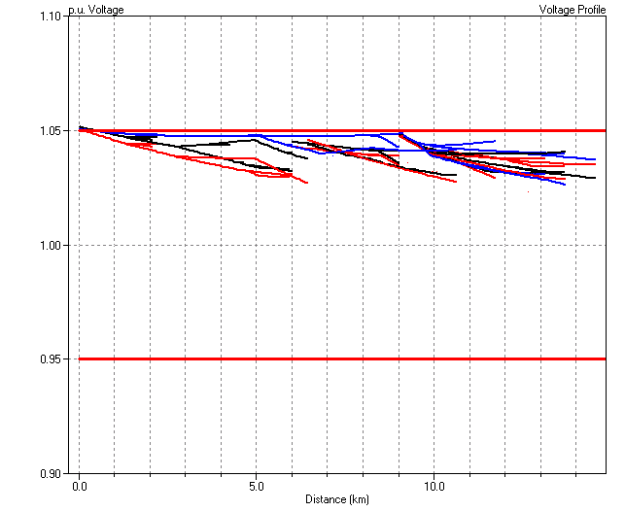
“Headroom” for PV
Voltage Profile for 100% Load
Voltage Profile for 40% Load
No Headroom for PV
This is the way it is most of the year !

Slide 148
Providing More Headroom
Lowering the Voltage Profile
Use DMS and Line-drop Compensation to Move Profile Lower to Allow More “Headroom” for DG
More efficient, too??

Slide 149
Planning for the Long Term
Provide more headroom for more hosting capacity
Lower the voltage profile
Flatten voltage profile with var sources
Smart Inverters
Volt-Var Control
Customer Load
Q1
Customer PV
Capacitive
System Voltage
VARs Generated
Q2
Q3
Inductive
V4
V1
V2
V3
Q4

Slide 150
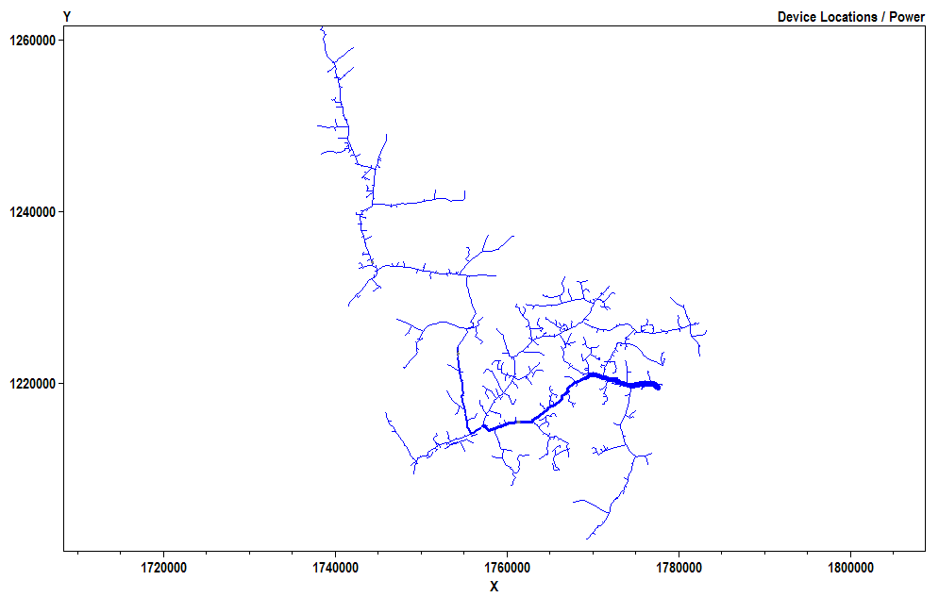
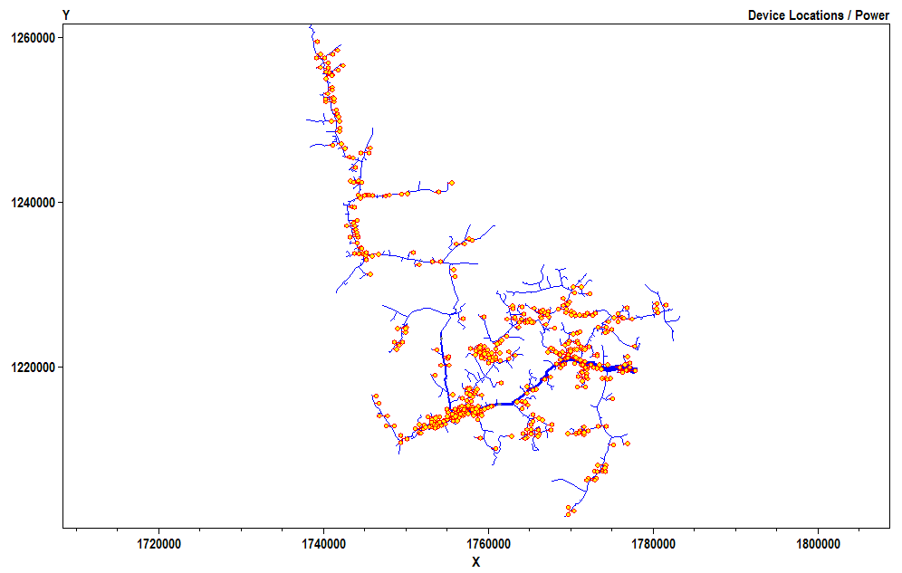
Use of Smart Inverters for Accommodating High-Penetration PV
Solar Rooftop PV
Solar Rooftop PV
With volt/var control
Volt-Var Control
Customer Load
Q1
Customer PV
Capacitive
System Voltage
Initial analysis indicated 25%-100% more PV can be accommodated using Volt/var control
VARs Generated
Q2
Q3
Inductive
V4
V1
V2
V3
Q4
20% PV
20% PV with volt/var control
Baseline – No PV
Source: J. Smith, T. Key “High-Penetration PV Impact Analysis on Distribution Systems,” Solar Power International, Oct 2011
24 Hour Simulation

Slide 151
Streamlined Hosting Capacity

Slide 152
Hosting Capacity
What is Hosting Capacity? Amount of PV that can be accommodated on a given feeder without impacting system operation under existing control and infrastructure configurations
Feeder Impact Issues of Concern
Voltage
Loading
Protection
Control
What could impact Hosting Capacity?
Feeder characteristics
DER size and Locations
DER type
Probable Issues
Possible Issues
No Issues

Slide 153
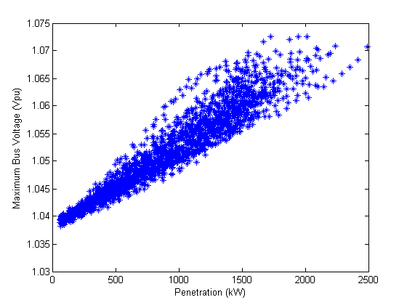
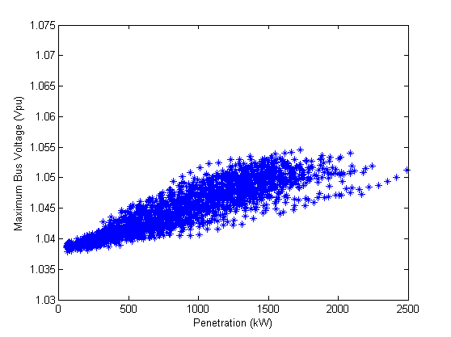
Detailed Hosting Capacity Study; Smart Inverters
Without Volt/var Control
Volt/var Control
ANSI voltage limit
Maximum Feeder Voltages (pu)
Maximum Feeder Voltage (pu)
ANSI voltage limit
5000 cases shown Each point = highest primary voltage
Increasing penetration (kW)
Increasing penetration (kW)
 |  | PV Hosting Capacity (kW)
 |  | Without Volt/var | With Volt/var
Primary Voltage Deviation | 1st violation | 938 | >2500
 | 50% scenarios with violation | 1323 | >2500
 | All scenarios with violation | 1673 | >2500
Primary Over Voltage | 1st violation | 540 | 880
 | 50% scenarios with violation | 871 | 1464
 | All scenarios with violation | 1173 | 2418
No observable violations regardless of size/location
160% increase in hosting capacity
60% increase in hosting capacity
Possible violations based upon size/location
Observable violations occur regardless of size/location

Slide 154
Detailed Study to Determine Hosting Capacity
Minimum Hosting Capacity
Maximum Hosting Capacity
Step 1: Create thousands potential DER deployments
Step 2: Run DER from zero to full output to identify the feeder responses
Step3: Determine hosting capacities based on feeder responses
DER at Unity Power Factor
Maximum Feeder Voltages (pu)
ANSI voltage limit
2500 cases shown Each point = highest primary voltage
Increasing penetration (kW)
No observable violations regardless of PV size/location
Possible violations based upon PV size/location
Observable violations occur regardless of size/location

Slide 155
Feeder Assessment Methods
Detailed Analysis – time consuming
Interconnection Screens – such as in FERC SGIP fast-track screening or in CA rule 21 screening procedures.
Streamlined Analysis – developed by EPRI using learnings from detailed analysis (last 1-2 years) to develop effective and time-efficient methods for analyzing larger numbers of feeders
Speed
Detailed Analysis
Streamlined Analysis
Interconnection Screens
Accuracy

Slide 156
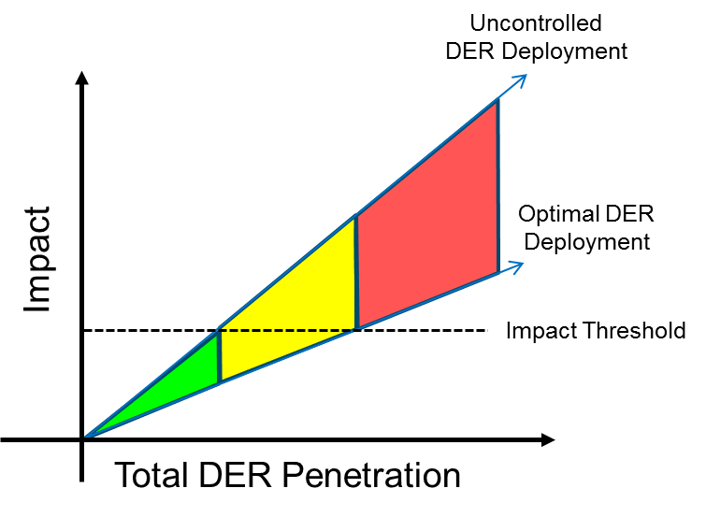
Streamlined Method Developed…
Captures what matters most
DER technology and impacts
DER size and location
Feeder design and operation
Impact Below Threshold
Impact Depends
Impact Above Threshold
Voltage
Protection coordination
Thermal capacity
DER Size and Location
Feeder Design and Operation
DER Technology and Impacts

Slide 157
Key Components of an Effective Method

Slide 158
Streamlined Hosting Capacity Method – Part 1
Input
Database of feeders from distribution planning software (CYME, Milsoft, Synergi,….)
The Method
Developed from years of detailed hosting capacity analysis
Considers range of DER sizes and location
Considers voltage, thermal, and protection impacts
Considers DER technology impacts
Works within existing planning tools
Output
Effectively and efficiently analyzes each and every feeder in system
Provides Node-level, feeder-level, and system-level hosting capacity
Issues found at X penetration
Locations where DER is more/less likely to cause grid issues
Database of existing distribution feeder planning models
Details on Streamlined Method: EPRI Report 3002003278, 2015

Slide 159
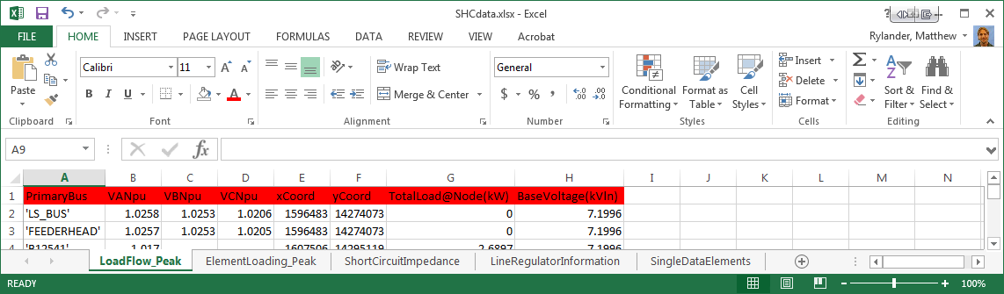
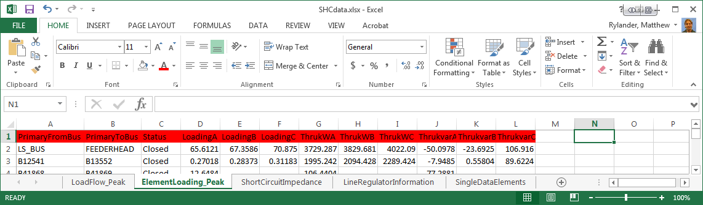
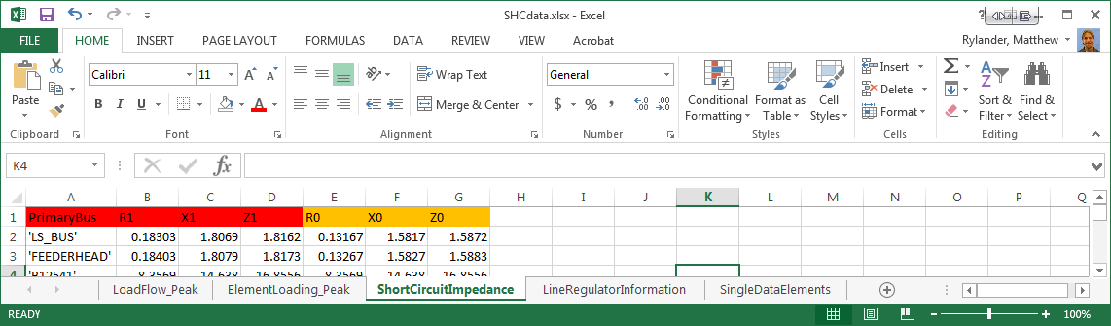
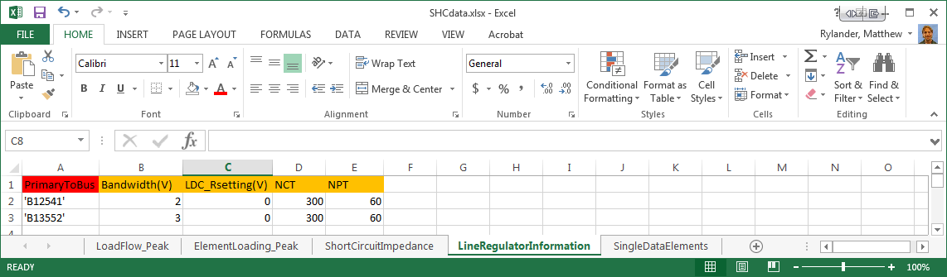
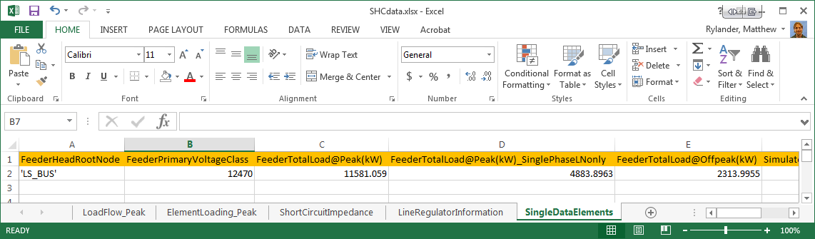
Utility Planning Tool Interface – Data Output
Load Flow Results
Repeated for offpeak load
Short Circuit Results
Sparse Model Data
Single Element Data

Slide 160
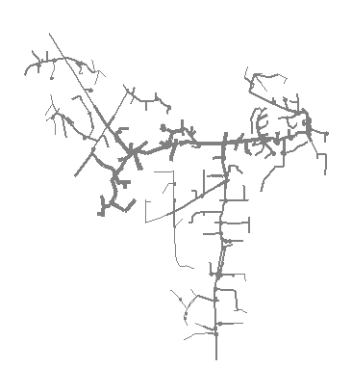
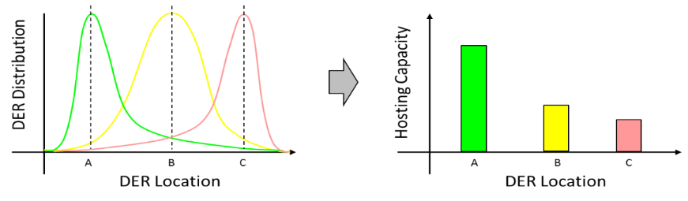

Streamlined Hosting Capacity Method – Part 2
Input
Database of feeders from distribution planning software (CYME, Milsoft, Synergi)
The Method
Developed from years of detailed hosting capacity analysis
Considers range of DER sizes and location
Considers voltage, thermal, and protection impacts
Considers DER technology impacts
Works within existing planning tools
Output
Effectively and efficiently analyzes each and every feeder in system
Provides Node-level, feeder-level, and system-level hosting capacity
Issues found at X penetration
Locations where DER is more/less likely to cause grid issues
On feeder-by-feeder, step thru range of locations/distributions to determine hosting capacity
Details on Streamlined Method: EPRI Report 3002003278, 2015

Slide 161
Streamlined Hosting Capacity Method – Part 3
Input
Database of feeders from distribution planning software (CYME, Milsoft, Synergi)
The Method
Developed from years of detailed hosting capacity analysis
Considers range of DER sizes and location
Considers voltage, thermal, and protection impacts
Considers DER technology impacts
Works within existing planning tools
Output
Effectively and efficiently analyzes each and every feeder in system
Provides Node-level, feeder-level, and system-level hosting capacity
Issues found at X penetration
Locations where DER is more/less likely to cause grid issues
Details on Streamlined Method: EPRI Report 3002003278, 2015

Slide 162
PV distributions
DER Options Considered
Distributed
Centralized

Slide 163
Hosting Capacity

Slide 164

Hosting Capacity – What it Encompasses
Impacts Considered
Voltage
Primary overvoltage
Primary voltage change
LTC/Regulator tapping
Secondary overvoltages
Secondary voltage change
Loading/thermal
Thermal loading (lines, transformers)
Protection
Reverse power flow
Total fault current
Breaker reduction of reach
Sympathetic tripping
Fuse coordination

Slide 165

Hosting Capacity – How do you Portray it

Slide 166


Implementation
Developed in
Cyme
Synergi
Milsoft (using OpenDSS)
PowerFactory
Applied to
Over 3000 feeders
Using all various software platforms
Currently
Finding more utility application
Advancing commercial planning tools
Adding new functionality
Incorporating EPRI’s Hosting Capacity Method into existing utility planning tool
Existing Planning Tools (CYME, Milsoft, Synergi)
EPRI Streamlined Hosting Module

Slide 167
Scripting Storage Models
See “OpenDSS STORAGE Element.PDF” in Distrib\DOC folder

Slide 168
Storage Element Model in EPRI’s OpenDSS
Idle | Discharge | Charge
% Eff. Charge/Discharge
Other Key Properties
% Reserve kWhRated kWhStored %Stored kWRated
etc.
kW, kvar
Idling Losses
kWh STORED

Slide 169
StorageController Element in OpenDSS
Time + Discharge rate Peak Shaving Load Following Loadshape
Discharge Mode Charge Mode kW Target Discharge Time Total Fleet kW Capacity Total Fleet kWh
et. al.
Comm Link
V, I
Substation
Storage “Fleet”

Slide 170
Simple Peak Shave Example with 3-Hour Storage
From EPRI
Smart Grid Demo - AEP
Community Energy Storage

Slide 171
Detail on Peak Shaving Application

Slide 173
“Ran Out of Gas”

Slide 175
12:00 is too early
Load declines after 12:00

Slide 176
Using Storage to Extend Solar PV
Source: EPRI, 2012, Analysis of Distribution System Effects of Energy Storage Through Simulation and Modeling, Palo Alto, CA, US. 1024285

Slide 177

Using Storage for Smoothing PV

Slide 178
Storage with Controller
Clear
New Circuit.TestStorage
~ BasekV=12.47
New Line.Line1 Bus1=Sourcebus LoadBus ! default line
New Loadshape.DailyShape npts=96 minterval=15 mult=[file=storagetestshape.csv]
New Storage.Battery phases=3 Bus1=loadbus kV=12.47 kW=250 kWrated=250 kWhrated=1000
~ dispmode=follow daily=dailyshape
set voltagebase=[12.47]
calcv
new monitor.PQ storage.battery 1 ppolar=no mode=1
new monitor.Vars storage.battery 1 mode=3
solve
solve mode=daily step=15m number=(2 96 *)
show mon PQ
show mon vars

Slide 179
The Loadshape

Slide 180
Result …

Slide 181
Storage with DynaDLL
clear
New Circuit.SimpleStore ! Creates voltage source (Vsource.Source)
Edit Vsource.Source BasekV=115 pu=1.02 ISC3=30000 ISC1=25000 !Define source V and Z
New Transformer.TR1 XHL=10
~ Buses=[SourceBus, Sub_Bus]
~ Conns=[Delta Wye]
~ kVs= [115 12.47]
~ kVAs=[200000 200000]
New Linecode.336ACSR R1=0.058 X1=.1206 R0=.1784 X0=.4047 C1=3.4 C0=1.6 Units=kft
New Line.LINE1 Bus1=Sub_Bus Bus2=LoadBus Linecode=336ACSR Length=0.011 Units=Mi
New Transformer.MVLV XHL = 5
~ Buses=[LoadBus LVBus]
~ Conns=[Delta Wye]
~ kVs= [12.47 .400]
~ kVAs=[300 300]
New Storage.Store1 phases=3 Bus1=LVBus kV=0.400 conn=Delta kVA=60
~ kWrated=60 kWHrated= 0.20833 %reserve=50 // 750 kW-s (kJ)
~ state=discharge
~ kW=50 PF=1
~ DynaDLL="C:\Users\prdu001\OpenDSS\Source\DESS1\Dess1.DLL"
! ~ DynaData=(help)
~ DynaData=(file=DESSModel_Test.TxT)
// New Load.LOAD1 Bus1=LoadBus kV=12.47 kW=1000 PF=.95 model=4 cvrwatts=1.2
Solve

Slide 182
Storage with Controller
new Storage.battery phases=3 bus1=loadbus kv=12.47
~ kwrated=250 kwhrated=1000
new StorageController.battery element=line.Line1
~ %Reserve=20.0
~ ModeCharge=Loadshape
~ ModeDischarge=Loadshape
~ Yearly=ls_bat_cntrl
~ EventLog=Yes

Slide 183
DG Screener Circuit Model Templates

Slide 184



DG Screener Circuit Model Templates
Default

Slide 185



DG Screener Circuit Model Templates

Slide 186


DG Screener Circuit Model Templates

Slide 187

Examining Transactions between OpenDSS and DG Screener
Edit Transformer.G1
~ Wdg=1
? Transformer.G1.conn
? Transformer.G1.kV
? Transformer.G1.kva
? Transformer.G1.tap
? Transformer.G1.bus
~ Wdg=2
? Transformer.G1.conn
? Transformer.G1.kV
? Transformer.G1.tap
? Transformer.G1.bus
? Transformer.G1.xhl
? Transformer.G1.%LoadLoss
Edit Transformer.G1
Transformer.G1.Wdg=1
~ Conn=WYE
~ kV=13.8
~ kva=5000
~ tap=1
~ Wdg=2
~ Conn=WYE
~ kV=4.16
~ tap=1
~ xhl=4
~ %LoadLoss=0.4
SetkVBase b7 4.16
Set Recorder=no
All Dialogs are populated using OpenDSS script commands

Slide 188


The Recorder File
The Recorder file is an OpenDSS feature that captures all text script transactions between OpenDSS and DG Screener
Toggle on/off
Show Recorder File will toggle off and display the file
Use the Recorder File to capture the template, edit, and run directly in OpenDSS

Slide 189
The DG Screener Screens

Slide 190


Voltage Change Analysis
PF=1.0
PF=-0.97

Slide 191


Short Circuit Analysis
SLG Voltage Profile

Slide 192

Open Conductor

Slide 193


Islanding Screen
SLG Fault Stays On
Breaker Opens
Voltages
Frequency

Slide 194


Voltage Fluctuations Screen for Solar PV
Library of PV Shapes

Slide 195
Using DGScreener to Generate Custom OpenDSS Models
Example of Building a Custom Circuit Model from a Template

Slide 196
Misc. DG Screener Issues and Exercises

Slide 197
Model for Direct-Connect Y-connected DG to avoid convergence issue
Insert a Yn-D Transformer in Series with delta-connected DG to achieve Y direct to avoid numerical problems in OpenDSS. Set Transformer XHL = DG’s %X₀

Slide 198
Questions, Requests, Examples

Slide 199

COM Server and C# Examples
Using Visual Studio 2013 Express Version

Slide 200


Create a New Visual C# Project …

Slide 201

Select Project > Add Reference …

Slide 202

Choose OpenDSSEngine from the List …

Slide 203

Add “using” clause in Code View ..
You will get a helpful hint

Slide 204

Add Public Variable for DSS object
Type is DSS (the editor will prompt you when you start to type it)
This is the main interface to OpenDSSEngine. The registered interface is “OpenDSSEngine.DSS”

Slide 205

From ToolBox, add a Button the Main Form to Load and Start OpenDSS
Double-Click this to create code for processing button click
Set the Text property of the button control to “Start &OpenDSS”

Slide 206

Start OpenDSS and Check if OK
Add public variable for Text interface after OpenDSS starts OK
This is the code generated to handle the button click (named StartButton)
This connects DSSObj variable to the COM server and loads the server
Attempt to start the OpenDSS program
If successful, assign the variable for the Text interface

Slide 207


Test it --- Success!
Click Start
Then click this
Now we’re off and running!

Slide 208

Solve the IEEE 123-Bus Test Feeder
TextBox with full path name of the IEEE123Master.DSS file
Add some stuff to the main form

Slide 209

Start Button Code
New Helper Variables
No message on successful start
Set the new variables

Slide 210

Compile Button Code
Sends Compile command to text interface
Contents of TextBox
Check Error Number on return
If error, show result message
Otherwise show “No Errors.”

Slide 211

Solve Button Code
Invoke Solve method in Solution interface
Check for lack of convergence

Slide 212

Show Results Button Code
Simply sends three commands to Text interface

Slide 213
What Do You want to Do?
Add other functions to the app or do other C# demos …

